Slide 1


Slide 2


Slide 3





Humans take a number of drugs for health reasons, it is practically guaranteed that all useful drugs will produce unwanted effects, but some can produce positively dangerous effects.
Toxicity refers to these sometimes deadly effects: Though all drugs have adverse effects at normal doses, it is only the dangerous ones which are referred to as toxic.
These are the result of excessive pharmacological action of the
drug due to overdosing or prolonged use.
After a lot a R&D potential drug candidates fail because of toxicity.

Slide 4


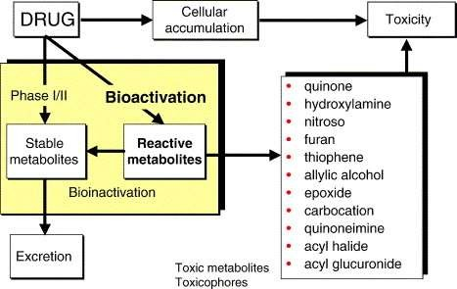
Toxicity may result from extension of the therapeutic effect of the drug, e.g. Coma by barbiturates, complete A-V block by digitoxin, bleeding due to heparin, etc.
The CNS, CVS, kidney, liver, lung, skin and blood forming organs are most commonly involved in drug toxicity.

Slide 5

Thus, drug toxicity, also called adverse drug reaction(ADR) or adverse drug event (ADE), is defined as the "manifestations of the adverse effects of drugs administered therapeutically or in the course of diagnostic techniques. It does not include accidental or intentional poisoning...”

Slide 6





Given By WHO:
Noxious and unintended response to medicinal product if a medicine is properly prescribed and administered.
Casual reaction between medicinal product and adverse event cannot be ruled out.
Medicinal errors are not included in this definition.
Given By MHRA:
An unwanted or harmful reaction experienced following the administration of drugs.
Suspected to be related to the drugs.
The reaction may be a known side effect of the drug or it may be new and previously unrecognised.

Slide 7






Elixir sulphanilamide was an improperly
prepared sulphanilamide medicine that caused
mass poisoning in the United States in 1937. It caused the deaths of more than 100 people.
1937
Thalidomide: West Germany- giving birth to deformed children with shortened limbs and no external ears. Later withdrawn.
1957
Clioquinol's use as an antiprotozoal drug was restricted or discontinued in some countries due to an event in Japan where over 10,000 people
developed SMON (subacute myelo-optic neuropathy)
Pemoline, for ADHD (attention deficit hyperactivity disorder), and troglitazone, for type-2 diabetes, were both shown to damage the liver.
1967
1990

Slide 8
Pioglitazone was withdrawn as it caused cadiotoxicity.
2013

Slide 9





Drug will do more harm than good in an individual patient depending on many factors, including the patient’s age, genetic makeup and preexisting conditions, the dose of the drug administered, and other drugs the patient may be taking.
On-target adverse effects, which are the result of the drug binding to its intended receptor, but at an inappropriate concentration, with suboptimal kinetics, or in the incorrect tissue
Off-target adverse effects, which are caused by the drug binding to a target or receptor for which it was not intended
Production of toxic metabolites.

Slide 10


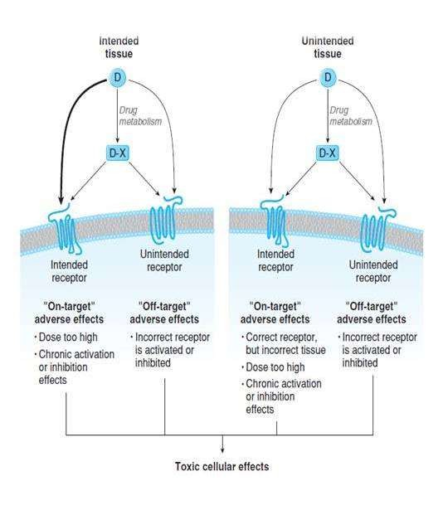
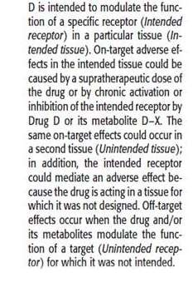
Production of harmful immune responses.
Idiosyncratic responses.

Slide 11







On-target adverse effects, which are the result of the drug binding to its intended receptor, but at an inappropriate concentration, with suboptimal kinetics, or in the incorrect tissue
An adverse effect may be an exaggeration of the desired pharmacologic action due to alterations in exposure to the drug.
Deliberate or accidental dosing error.
Alterations in the pharmacokinetics of the drug.
By changes in the pharmacodynamics of the drug-receptor interaction that alter the pharmacologic response.
All this causes an increase in the effective concentration of the drug and thus to an increased biological response.

Slide 12

An important class of on-target adverse effects may occur because the drug, or one of its metabolites, interacts with the appropriate receptor but in the incorrect tissue. Many drug targets are expressed in more than one cell type or tissue.
Example:
The antihistamine diphenhydramine hydrochloride is an H1 receptor antagonist used to reduce the unpleasant symptoms of histamine release in allergic conditions.
Diphenhydramine also crosses the blood-brain barrier to antagonize H1 receptors in the central nervous system, leading to somnolence.
This adverse effect led to the design of second-generation H1 receptor antagonists that do not cross the blood-brain barrier, and so do not induce drowsiness.

Slide 13

Sometimes on-target side effects unmask important and previously unknown functions of the biologic target.
Example:
The administration of hydroxymethylglutaryl coenzyme A (HMG CoA) reductase inhibitors (so-called statins), which are used clinically to decrease cholesterol levels.
A rare adverse effect of statin therapy is muscle toxicity, including rhabdomyolysis and myositis; this side effect is due to the physiologic role of HMG CoA reductase in regulating the post translational modification of several muscle proteins through a lipidation process called geranyl-geranylation.

Slide 14




The drug interacts with unintended targets. Indeed, few drugs are so selective that they interact with only one molecular target.
Example:
The antihistamine terfenadine, which also inhibits a cardiac potassium channel (hERG).
The unintended inhibition of the ion channel unfortunately led to fatal cardiac arrhythmias in some patients, and terfenadine was withdrawn from the market for this reason.
The active metabolite of terfenadine, fexofenadine, was later discovered to inhibits the hERG channel only weakly, and fexofenadine is now marketed as a safer antihistamine.

Slide 15




Virtually all drug molecules are metabolized by the liver and/or other tissues. Sometimes metabolism produces a pharmacologically active metabolite, a drug metabolite can have an adverse effect. A clinically significant example is that of acetaminophen, a commonly used analgesic and antipyretic.
In therapeutic dose range, acetaminophen is metabolized Predominantly by glucuronidation and sulfation, and these conjugated products account for approximately 95% of the total excreted metabolites. P450 enzymes oxidize a small percentage of
acetaminophen to benzoquinoneimine, glutathione.
a reactive intermediate, which is immediately conjugated to
N-acetyl-

Slide 16

However, when therapeutic range, the
the level of
acetaminophen
exceeds the
glucuronidation and sulfation pathways
become saturated and the stores of glutathione in the liver become depleted. This results in excessive accumulation of N-acetyl- benzoquinoneimine, an electrophile that reacts with nucleophilic groups on proteins to produce covalent protein derivatives.
An antidote for acetaminophen overdose is N-acetylcysteine, which reacts directly with (and thereby detoxifies) the iminoquinone. Administered within 8 to 16 hours of an overdose of acetaminophen, N-acetylcysteine can be lifesaving.

Slide 17








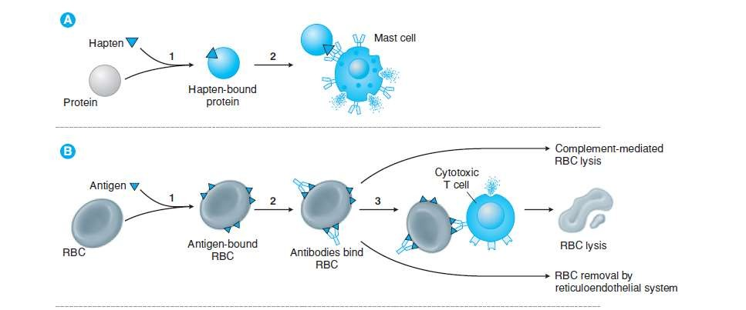

Slide 18


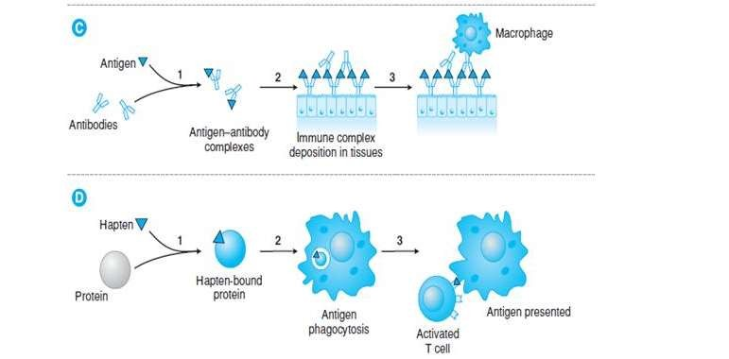
Mechanism of hypersensitivity reactions.A.Type I hypersensitivity reactions occur when hapten binds to a protein(1).The antigen crosslinks IgE antibodies on the surface of mast cell degranlation (2).Mast cells release histamine and other inflammatory mediators.B. Type II hypersentivity reactions occur when an antigen binds to the surface of a circulating blood cell, usually a red blood cell (RBC) (1).Antibodies to the antigen then bind surface of the RBC (2), attracting cytotoxic T cells (3), which release mediators that lyse the RBC binding of Ab to EBCs can also directly stimulate complement –mediated RBC lysis & RBC removal by the reticuloendothelial system. C. Type III hypersensitivity reactions occur when Ab bind to a soluble toxin, acting as an antigen (1).The antigen-antibody complexes are then deposited in the tissues (2), attracting macrophages (3) and starting a complement-mediated reaction sequence (not shown).D. Type IV hypersensitivity reactions occur when a hapten binds to a protein (1) and the hapten-bound protein is phagocytosed by a Langerhans cell (2).The Langerhans cell migrates to a regional lymph node ,where it presents the antigen to a T cell ,thereby activating T cell(3)

Slide 19


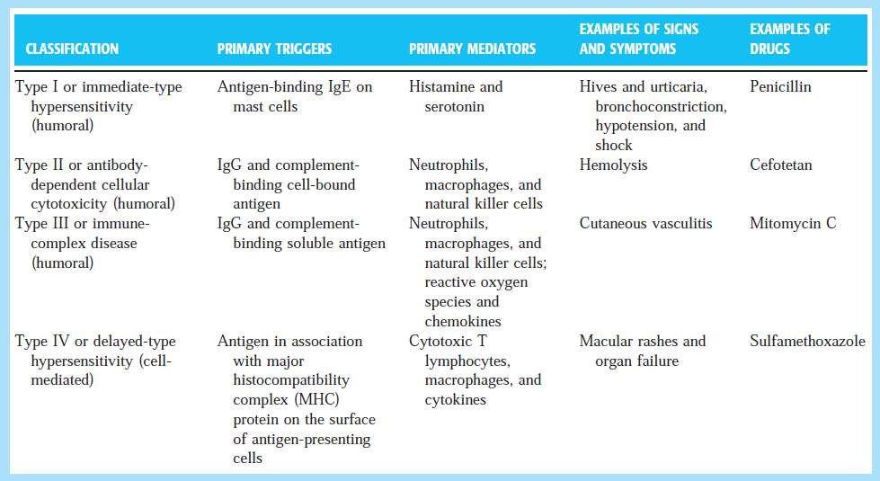

Slide 20









Idiosyncratic drug reactions are rare adverse effects for which no obvious mechanism is apparent.
These idiosyncratic reactions are often thought to reflect unique individual genetic differences in the response to the drug molecule, possibly through variations in drug metabolism or immune response.
Idiosyncratic reactions are difficult to explain and often difficult to study in animal models, precisely because the genetic variation that may be causing the adverse response is not known.
It is believed that the systematic study of patient variations in response to different drugs (pharmacogenomics) may help
to elucidate the mechanisms that underlie idiosyncratic drug reactions.

Slide 21






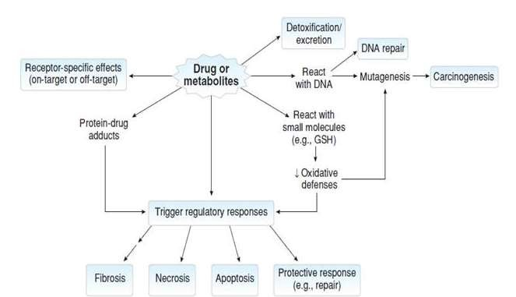
Mechanism of drug toxicity: A drug or its metabolites or both interact with specific receptors to mediate ON-TARGET or OFF-TARGET adverse effects .In addition, metabolites can be detoxified & excreted , or can react with a variety of macromolecules including DNA, small antioxidants such as glutathione (GSH), or cellular or plasma proteins. The formation of unpaired DNA adduct is often mutagenic & may lead to cancer. The impairement of oxidative defences can lead to inflammation & cell death. The formation of drug-protein adducts can trigger immune responses that can damage cells & tissues. Regardless of the mechanism of damage, a gradation of acute responses from protective to apoptosis & necrosis can result, depending on the extent of damage & the temporal & dose relationship. Chronic inflammation & repair can lead to tissue fibrosis

Slide 22





Cytotoxicity.
Carcinogenicity.
Mutagenicity.
Teratogenicity.

Slide 23



This is the simplest form of drug toxicity, where the drug or an active metabolite causes serious damage to the cells.
Often, the cells of a specific organ are affected, causing a potentially fatal loss of function of the liver or kidney,
damage to the eyes or ears, or abnormal clotting of the blood.
Types of cytotoxicity
Non-covalent interactions
Lipid peroxidation
Generation of toxic reactive oxygen species
Reactions causing depletion of
glutathione (GSH)
Modification of sulfhydryl groups.
Covalent interactions
Hepatotoxicity e.g. Paracetamol
Nephrotoxicity e.g.Aminoglycosides

Slide 24


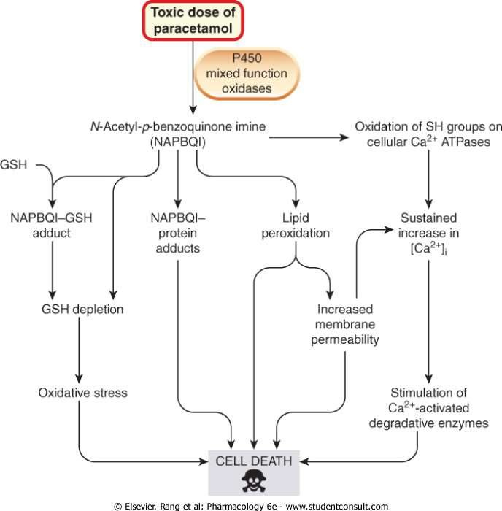

Slide 25



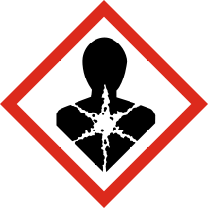
A carcinogen is any substance, radionuclide, or radiation that is an agent directly involved in causing cancer. This may be due to the ability to damage the genome or to the disruption of cellular metabolic processes.
Several radioactive substances are considered carcinogens, but their carcinogenic activity is attributed to the radiation, for example gamma rays and alpha particles, which they emit.
Examples of non-radioactive
carcinogens are inhaled asbestos,
certain dioxins, and tobacco smoke.
The hazard symbol for carcinogenic chemicals in the Globally Harmonized System.

Slide 26



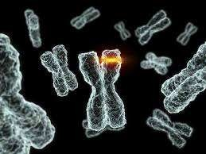
Some drugs can cause permanent changes to the DNA of germ cells - egg cells and sperm cells - leading to mutations which are inherited by a patient's children.
Example is nitrogen mustard, that destroys cancer cells by linking their DNA strands together
with a nitrogen atom, but can also link the DNA of germ cells, leading to deletions of DNA bases, thereby causing mutations.

Slide 27



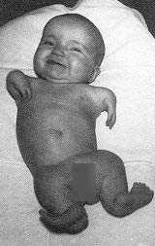
Some drugs can cause defects in the development of the foetus, leading to gross abnormalities of the baby: known as teratogenicity
The type of abnormality seen depends on the stage at which the drug is taken, as different organs develop at different times during pregnancy.
For instance, thalidomide taken after
21 days of pregnancy will often lead to lack of external ears and paralysis of the cranial nerves3, whereas thalidomid taken after 27 days will lead to limb Malformation (phocomelia).

Slide 28




Toxicity can be measured by the effect the substance has on an organism, a tissue or a cell.
We know that individuals will respond differently to the
same dose of a substance because of a number of factors including their gender, age and body weight.
Therefore a population-level measure of toxicity is often used.
The probability of an outcome for a population is then related to a given individual in a population.

Slide 29

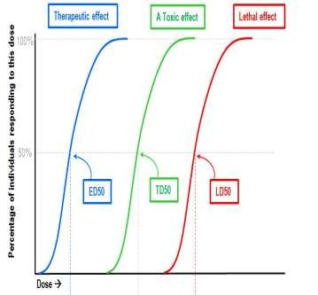
Lethal dose (LD₅₀)
One such population-level measure is
the median lethal dose, LD50
(lethal dose, 50%). This is defined as the dose required to kill half the members of a specific animal
population when entering the animal’s body by a particular route. LD₅₀ is a general indicator of a substance’s toxicity within a short space of time. It is a measure of acute toxicity.
Most users of a substance will want to know the toxicity of that substance. The information for an LD₅₀ must include the substance, the route of entry and the animal species. For example, table salt has an oral LD₅₀ of 3 gm/kg in rats. Paracetamol has an oral LD₅₀ of 1.944 gm/kg in rats.

Slide 30

Fixed-dose procedure
In 1992, the fixed-dose procedure (FDP) was proposed as an alternative test to LD₅₀. It uses fewer animals, and there is less pain and suffering.
In this procedure, the test substance is given at one of four fixed-dose levels (5, 50, 500 and 2000 milligrams per kilogram) to five male and five female rats.
When a dose produces clear signs of toxicity but no death is identified, the chemical is then classified at that level.

Slide 31




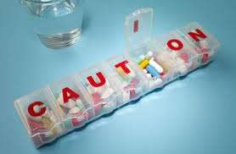
Banning dangerous drugs, or
By strictly controlling their uses.
Drugs must go through both
rigorous animal testing and
small-scale trials on humans to detect unexpected effects
To advise doctors not to prescribe their drugs to pregnant women.
Child-proof containers have also been developed and clear labelling is used to warn patients of risks.
Potentially fatal drugs are sold in restricted amounts in blister packs, making it difficult to take enough pills for the drug to have toxic effects.

Slide 32




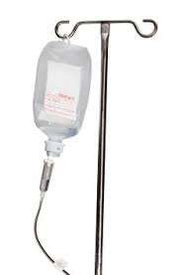
The first line of defence is to remove the drug from the patient before it is fully absorbed, and techniques include:
Irrigation to remove drugs applied to the eyes or skin.
Gastric lavage, where the stomach is washed out and drained using tubes.
Activated charcoal, which is swallowed and soaks up the drug from the gut.
Ipecac syrup, which causes vomiting in order to empty the stomach.
Cathartics, laxatives which purge the drug from the gut.

Slide 33

A second line of defense involves the removal of thedrug from the bloodstream by various methods, including:
Changing urine pH to increase excretion of the drug into the urine.
Forced diuresis, where drugs are given to increase urine production.
Haemodialysis, where the blood is passed through a machine to remove the drug.
Exchange transfusion to replace the patient's drug-filled blood with fresh blood.

Slide 34


